Slide 1



FLIPKART
FLIPFIT APPLICATION

Slide 2




JEDI 2.0 - 2024 - FLIPKART - DEVELOPMENT TEAM - H
FLIPFIT APPLICATION
Shruti Grover
Hriday Ahuja
Neel Yashodhan Khare
Arjita Nema
Sridasyam Aditya
Simran Saigal
Isha Rani
Divya Rai
01

Slide 3


STAKEHOLDERS
Sponsors: Flipkart
SME’S: Amit Balyan
Trainers: Amit Balyan
Sharath Ramasha

Slide 4

6 DAYS
6 DAYS OF TRAINING
+
PROJECT DEMO
96 HOURS
5760 MINUTES
345600 SECONDS
EVERLASTING KNOWLEDGE
POTENTIAL MAXIMIZED

Slide 5

AGENDA
Journey Roadmap
Our Team
Project Goals
1.
2.
3.
Engineering Practices
Tech Stack
6.
Challenges and Learning
4.
5.
Demo
Questions
7
8.

Slide 6






OUR JOURNEY MAP
Learnt about various Git Commands like git init, git checkout, git add , git config to lay the foundation for collaborative working.
started building our projects on Spring Tool Suite by creating various interfaces and classes and implementing the functionalities.
Learnt How to migrate the client layer to Rest API using Dropwizard framework & completed the development process.
Day 1
Day 2
Day 3
Day 4
Day 5
Day 6
Created Activity Diagram, Use case Diagram and Class diagrams using Lucid Chart Platform.
Basic understanding of Java Concepts and Built the structure of the FlipFit project by creating various packages and classes.
Integrated the DAO layer with the SQL Database and fetched data.

Slide 7
Framework for 6 Days
Everyday discussion about technologies, implementation and doubt clearance on topics like UML Diagrams, Git Control, Java, Database, Dropwizard.
6 days of immense learning, hands on experience, teamwork and collaboration, interactive sessions and discussions.
Everyday discussion with SME/Trainer on Project progress & transformation based on learnt concepts.

Slide 8





T
E
A
M

Slide 9
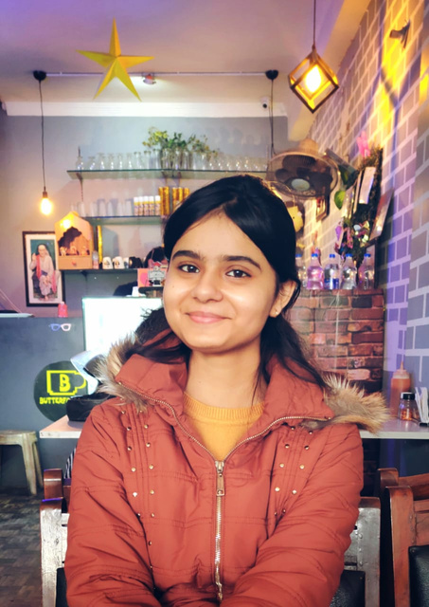
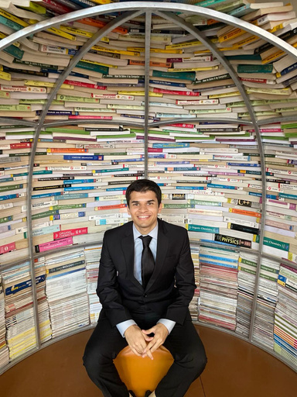



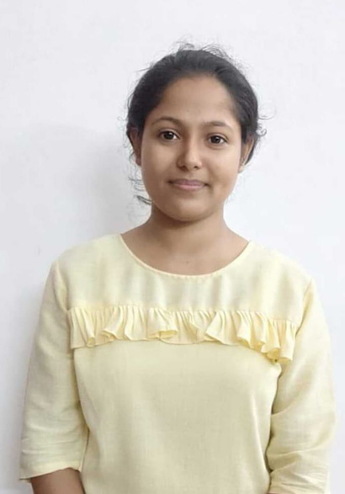
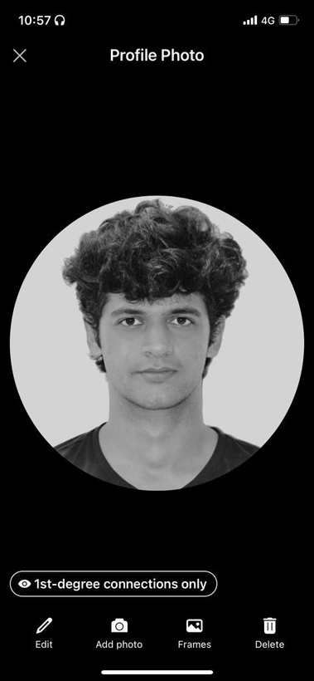
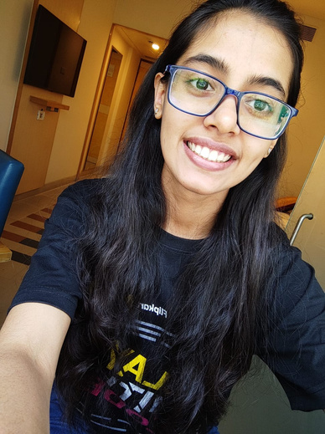
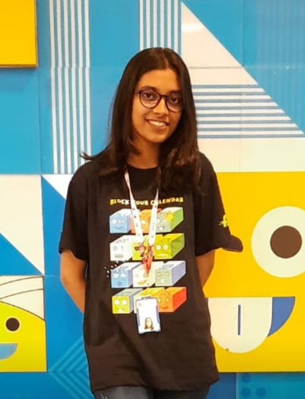
Shruti Grover
Neel Khare
Arjita Nema
Sridasyam Aditya
Team Lead
Team Member
Team Member
Team Member
Isha Rani
Hriday Ahuja
Simran Saigal
Divya Rai
Team Member
Team Member
Team Member
Team Member

Slide 10



Project Goals
To create FlipFit - a Gym Management System
Customer
Gym Owner
Admin
Register on the platform
Login on the platform
View gyms and available gym slots
Book gym slot
View booked gym slot
Cancel booked slot
Register on the platform
Login on the platform
Add gyms and gym details
Edit gym details
Add slots for gym
View gyms and gym requests.
Approve gym owner and gym requests.

Slide 11


ENGINEERING
PRACTICES
1.
Adding Comments
2.
Error and Exceptional Handling
3.
DAO
4.
Seperation of Concerns
5.
Version Control

Slide 12







TECH STACK
Version Control
Integrated Development Environment
Database
Programming Language & Frameworks
Tools

Slide 13

Challenges:
Installation of required Softwares
Working with new tech stacks and frameworks.
Team collaboration and synchronisation using Git
Ensuring code integrity within tight deadlines.

Slide 14


LEARNINGS
Significance of UML diagrams
Hands-on experience with Git commands
Introduction to new concepts of Java like exception handling, database connection, generation docs
Deep understanding of Dropwizard, REST API’s and JAX_RS

Slide 15

DEMONSTRATION

Slide 16






Q&A

Slide 17


Thank You
Amit Sir

